Slide 1
Sustainable Concrete
Industrial waste is your resource
www.resourcefull.eu

Slide 2
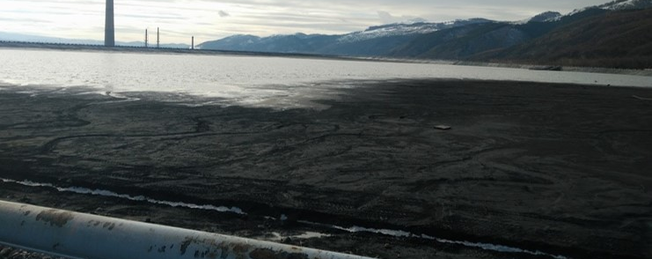
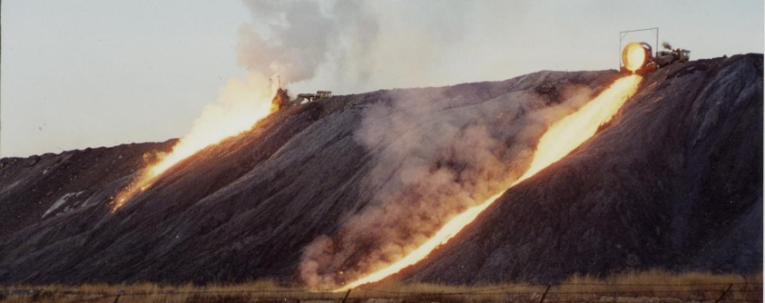
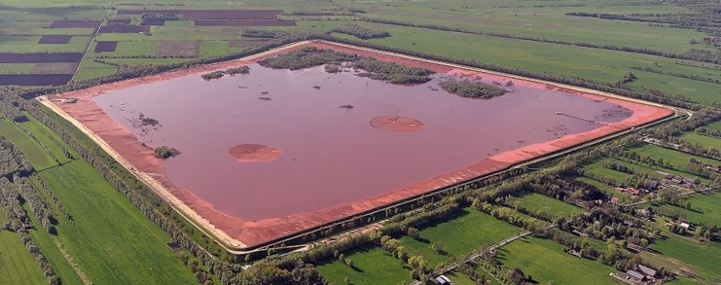
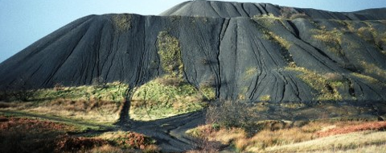
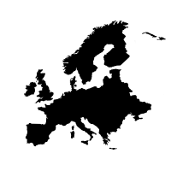
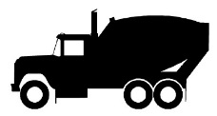
ResourceFull finds use for industrial by-products and transforms them into minerals suitable for the production of a new generation of concrete.
Non-existing or
low value
applications
Metal industry
Concrete industry
Europe & world
Huge waste piles with low value or non-existing applications
OPC dependency
Eco-friendly alternative: up to 90% CO₂ reduction
Dependancy on primary raw materials
CO₂ reduction of construction industry

Slide 3
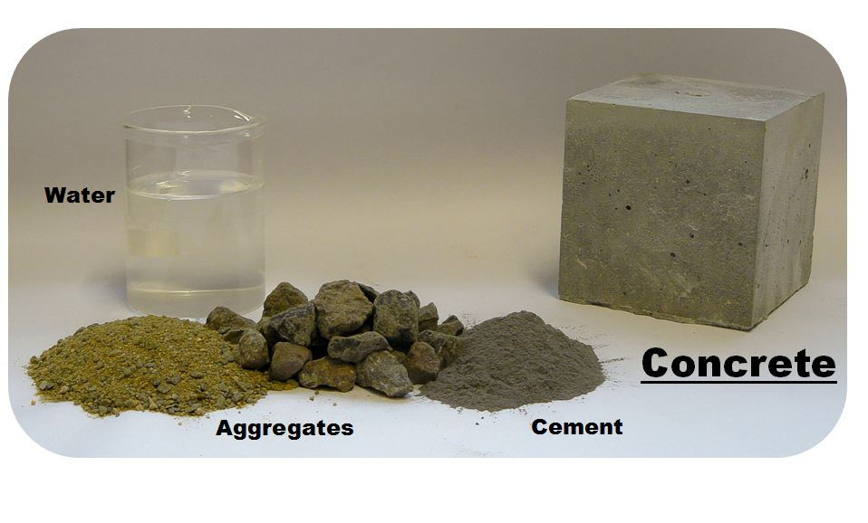
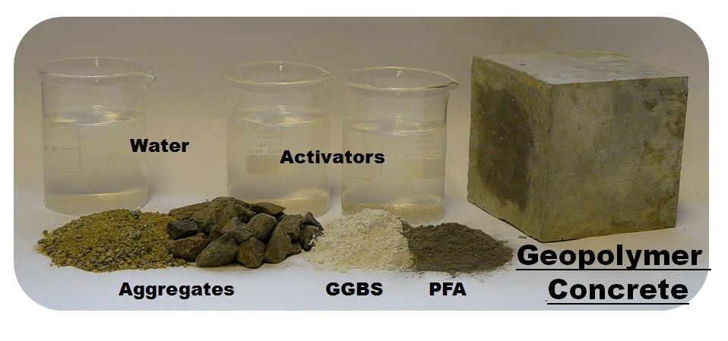
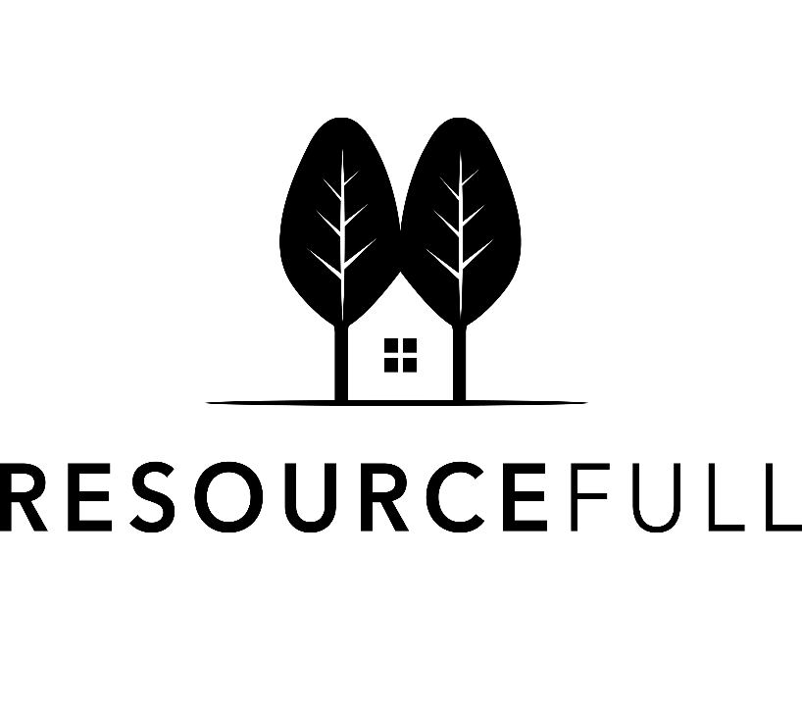
Our technology
Tailor made activation blend
per residue
per application

Slide 4
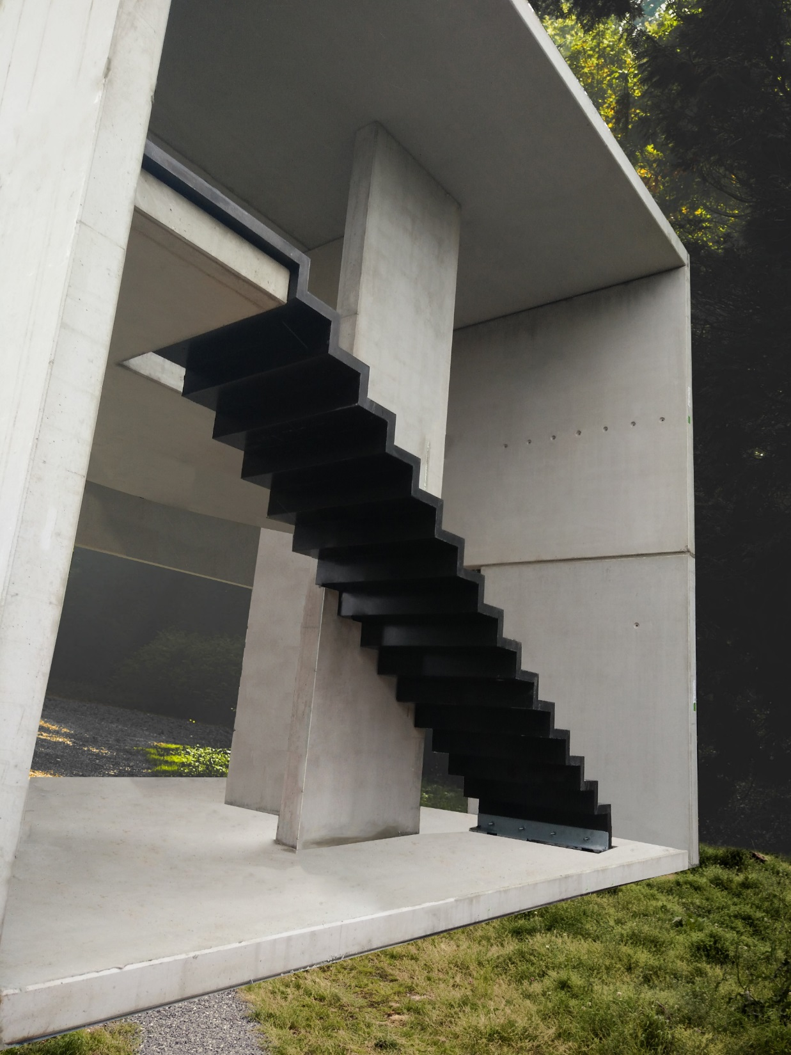
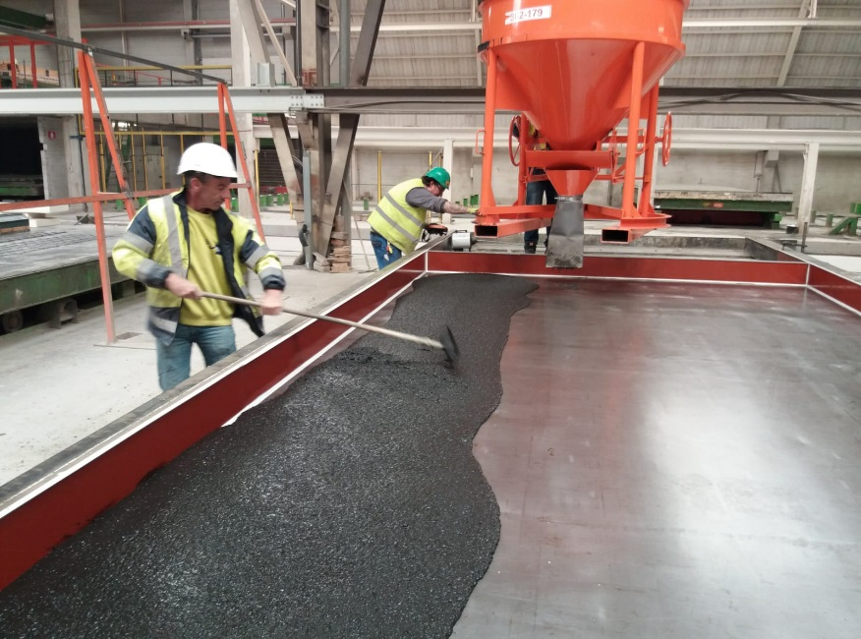
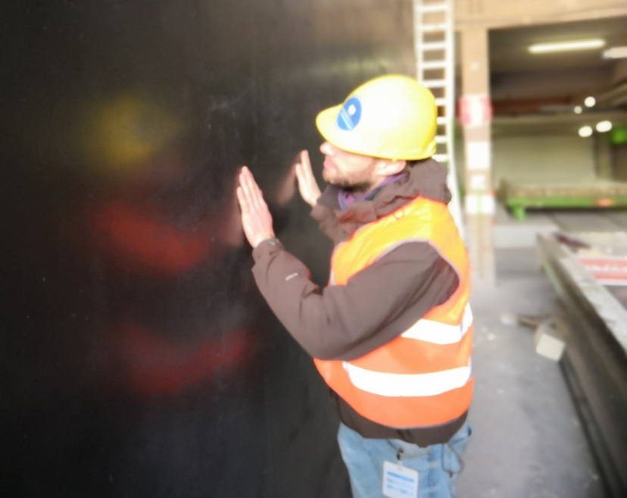
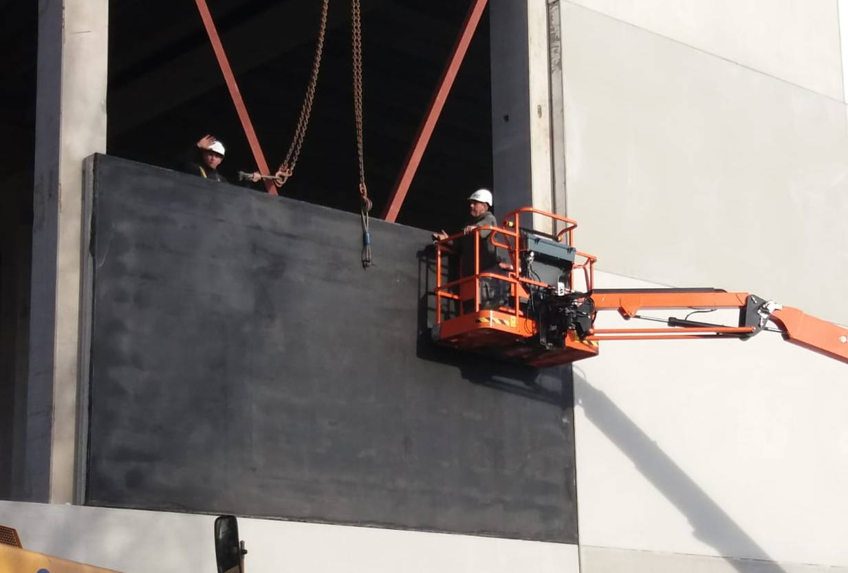

Slide 5
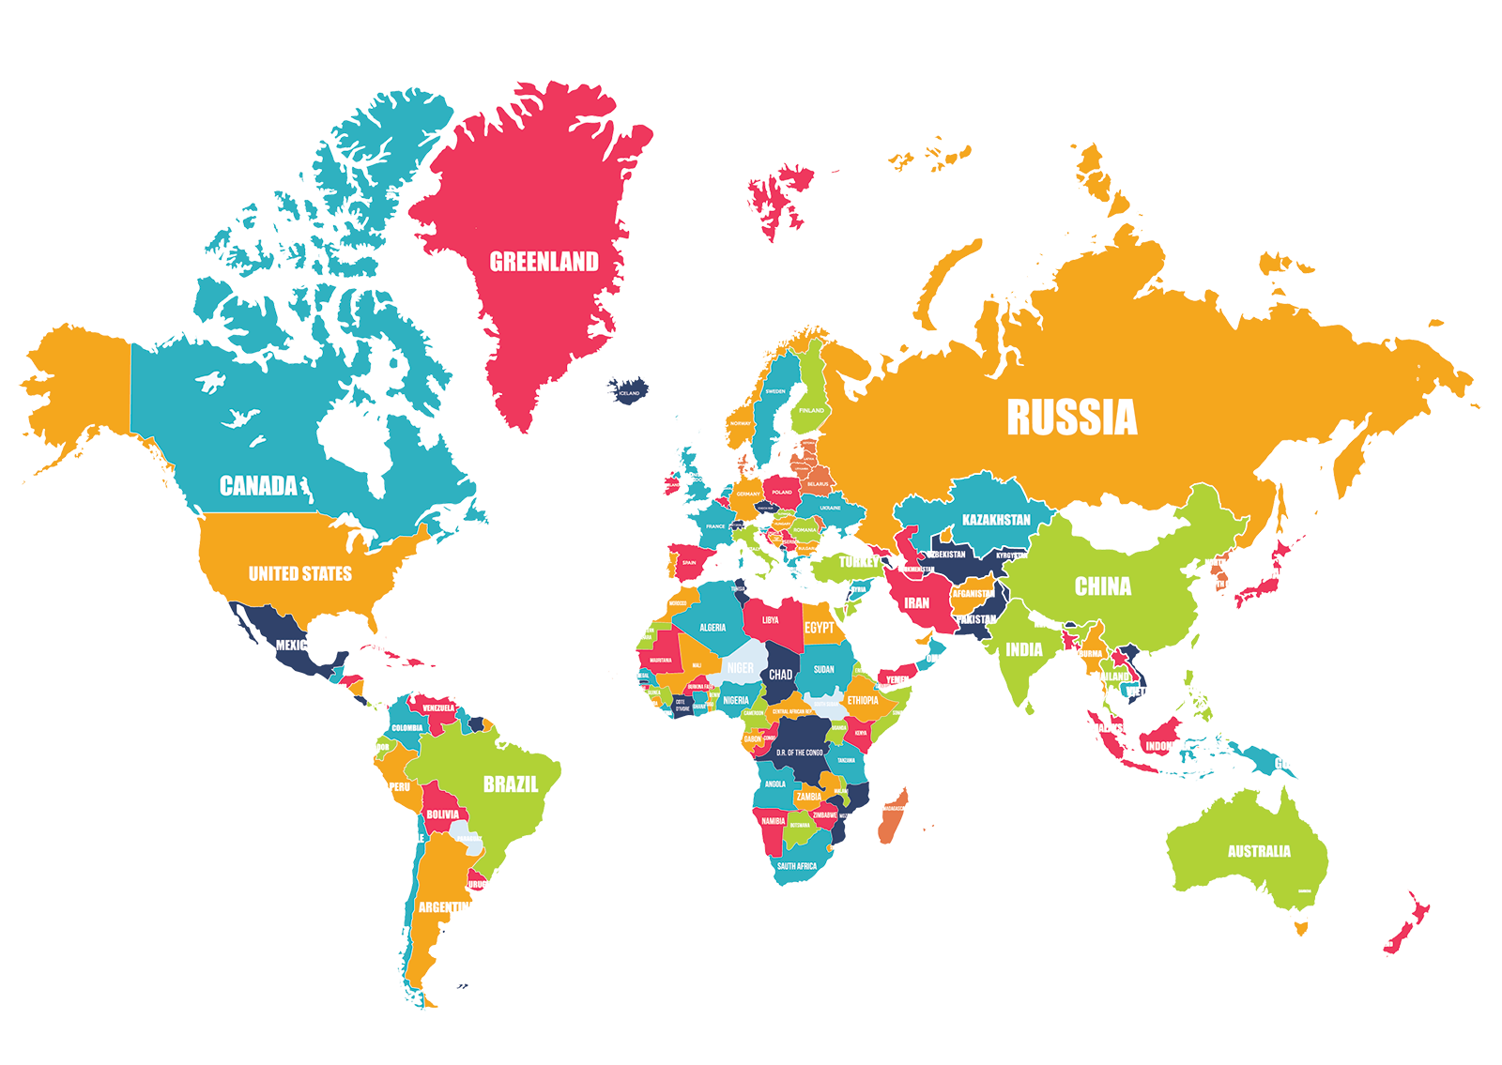
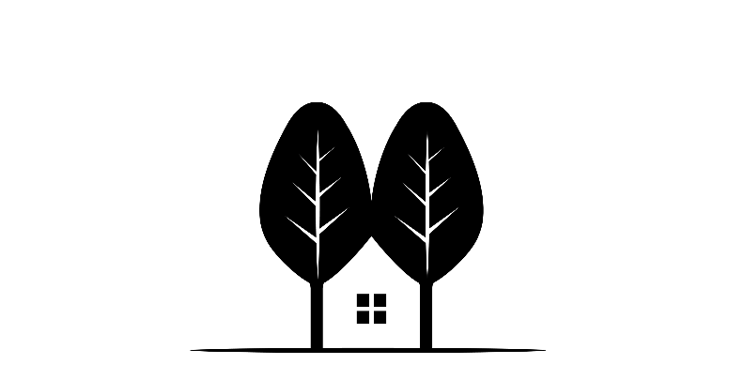
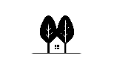
Building a greener future, together
ResourceFull
Industrieweg 1119
3540 Herk-de-Stad
Belgium
www.resourcefull.eu
Lukas Arnout
lukas.arnout@resourcefull.eu
Wouter Crijns
wouter.crijns@resourcefull.eu

